Slide 1
My passion
Yoshimasa Kitano

Slide 2
~Self introduction~
・Name: Yoshimasa Kitano
・Old: Nineteen years old
・Study: Security
・Future dream: White hat hacker
Notes:
Hello.My name is Yoshimasa Kitano.I'm nineteen years old.I'm studying security at OCA because I want to be a white hat hacker I want to work using my security knowledge.

Slide 3
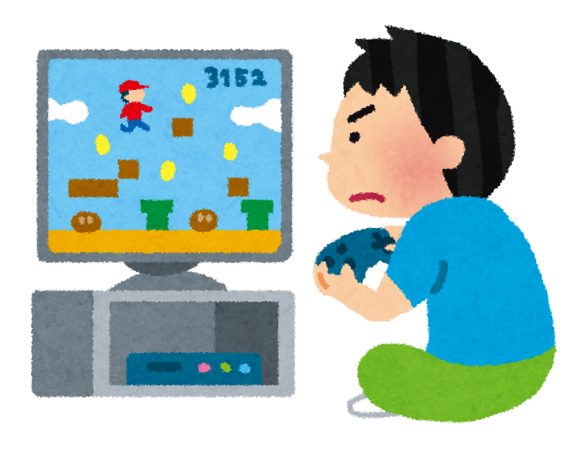
~My passion~
Playing
video games
Notes:
My passion is playing video games because playing them is a lot of fun.Especially,playing with friends is very exciting.I have been interested in playing games for eight years.I play in my free time at home with my Internet friends.
Eight years ago,my friend invited me to play.I was interested in it at that time.My friend said that Video games make us happy.I want to play with a lot of friends,so I told my other friends about playing games.

Slide 4
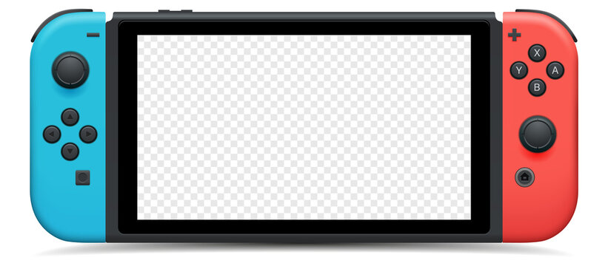
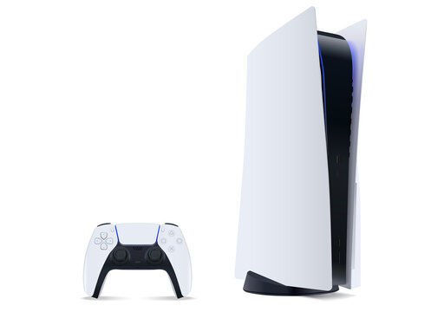

Notes:
There are many kinds of,so the device someone must buy depends on what kinds of video games they want to play.The devices include Nintendo Switch,PlayStation,PC,etc.If you would like to play ,you shouldn't play too much because you will get addicted.

Slide 5
~History~
・Developed : American company in 1972
・Famous company : Nintendo, Sony
Notes:
It seems that video games have a history.I didn't know about the history of them,so I searched it.Computer games developed by an American company in 1972 and from there games gradually became famous.They have been popular in Japan since 1972.Famous companies are Nintendo and Sony. There are many people in the world who have developed many games,

Slide 6
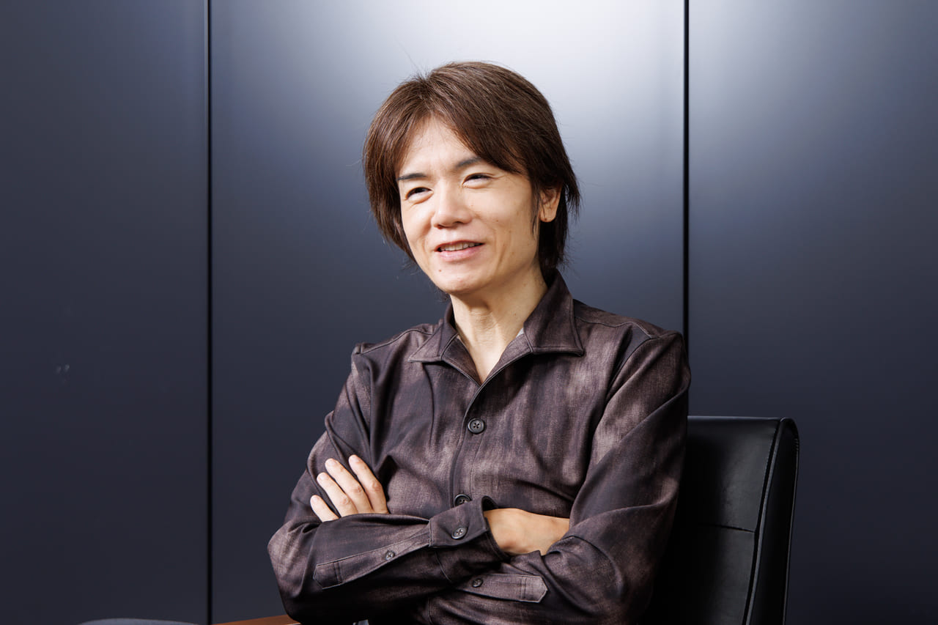
~My favorite person~
Sakurai
Masahiro
Notes:
and I would like to introduce some of my favorite person.I like Sakurai Masahiro.

Slide 7


Notes:
He developed Super Smash Bros and Kirby's Dream Land.I like Kirby,so I thank him.

Slide 8
~Career~
・Future: work in the security field
→It is relevant to my career.
・Importance: communicating, teamwork
・Will learn: Focusing on something
・paid for: Worth the money
Notes:
And then,I like playing video games and I think I will continue this interest in the future.
By the way,I want to work in the security field in the future,so I don't think it is relevant to my career.But,they I play most often are games that require team play,so I learned the importance of communicating with my friends and the importance of teamwork.I think I will learn the importance of focusing on something.And then,I'm not good enough at the game to win any prize money,so Idon't think it would be worth the money.

Slide 9
~In conclusion~
・anyone enjoy playing games
・make them a hobby
Notes:
In conclusion,anyone enjoy playing games and make them a hobby,even if they are'nt good at them. We encourage you to make games your hobby.

Slide 10
Thank you for listening!
Notes:
Thank you for listening

